Slide 1



PEILab Group Meeting
Leader: Zicong Hong
Team Member: Jian Lin, Haodong Wang, Qianli Liu, Kaibin Guo, Junjie Liu

Slide 2
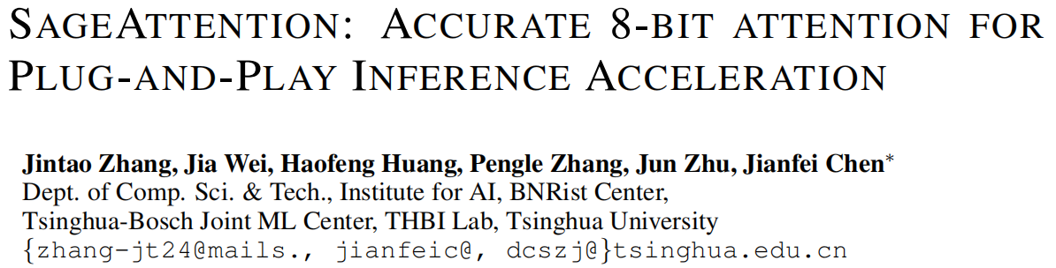
SageAttention
ICLR’25

Slide 3
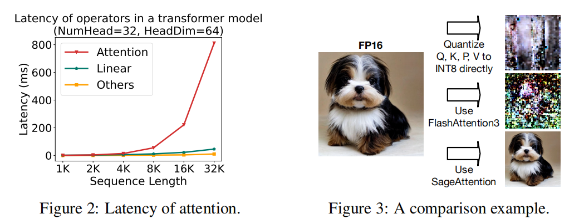
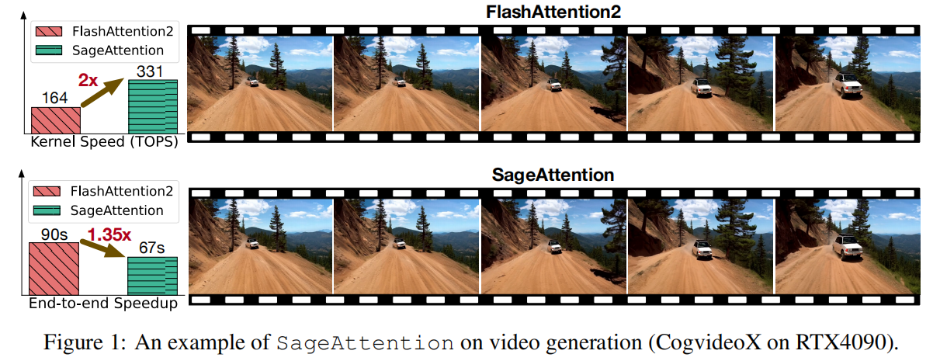
SageAttention

Slide 4
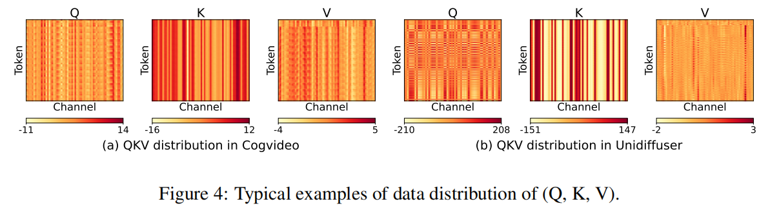
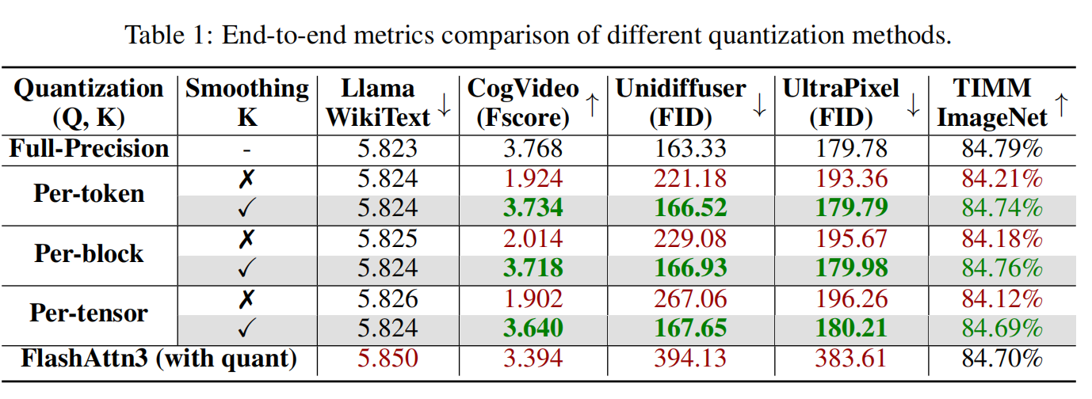
SageAttention
Challenge
Result
Key 矩阵在通道维度上有较多异常值，常规量化易造成信息丢失
Solution: Smooth Matrix K

Slide 5
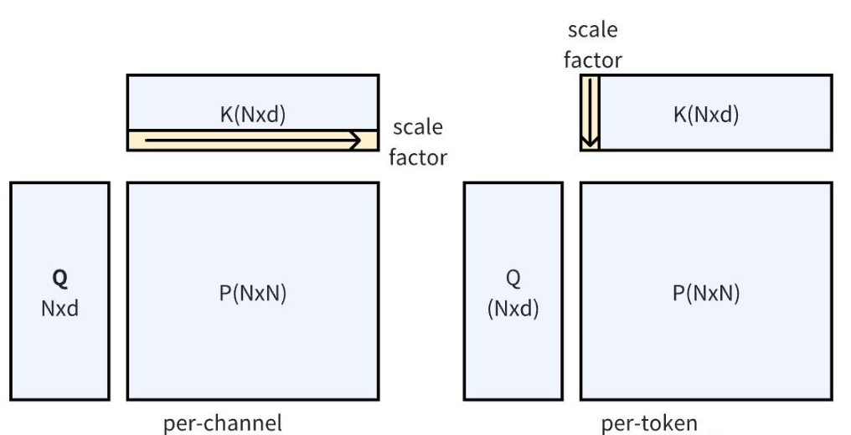
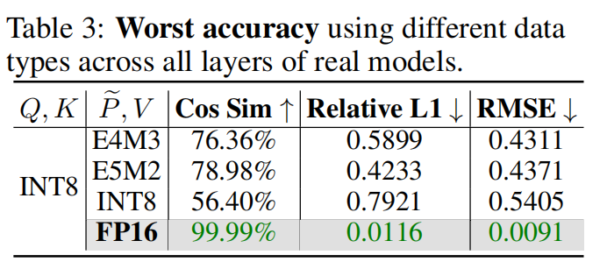
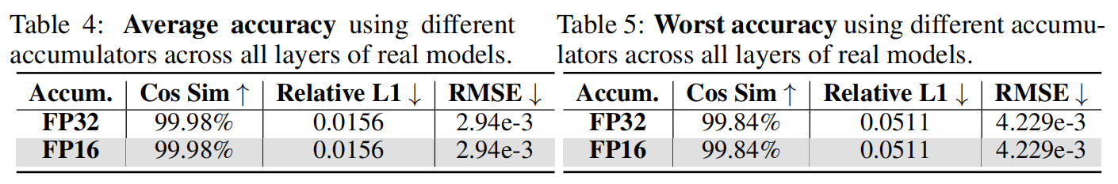
SageAttention
QUANTIZATION FOR Q, K
QUANTIZATION FOR P, V
Quantization granularity for P, V: use Quan(P) in per-block and Quan(V) in perchannel.
Quantization granularity for Q, K: only per token, per-block or per-tensor.
Data type of P, V: choose INT8 for Q and K.
Data type of Q, K: choose INT8 for Q and K.
Much more accurate and efficient solution: FP16 Accumulator

Slide 6
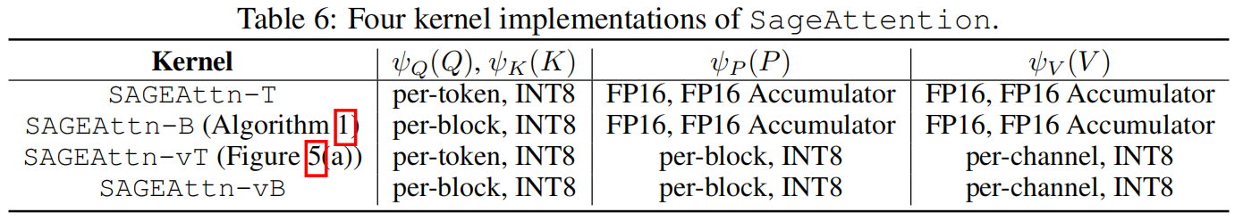
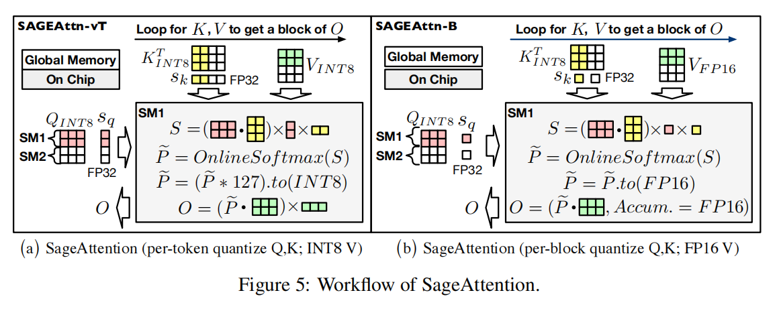
SageAttention

Slide 7
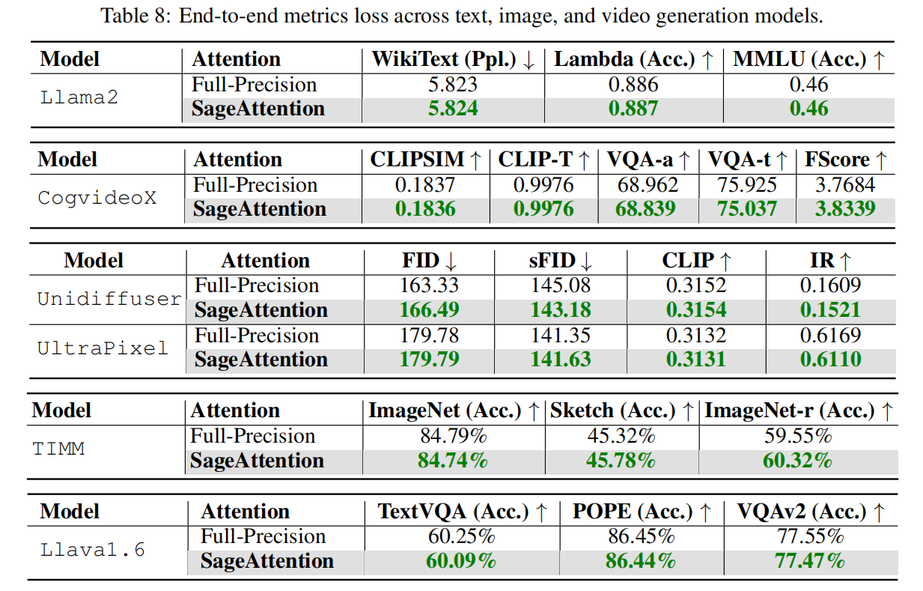
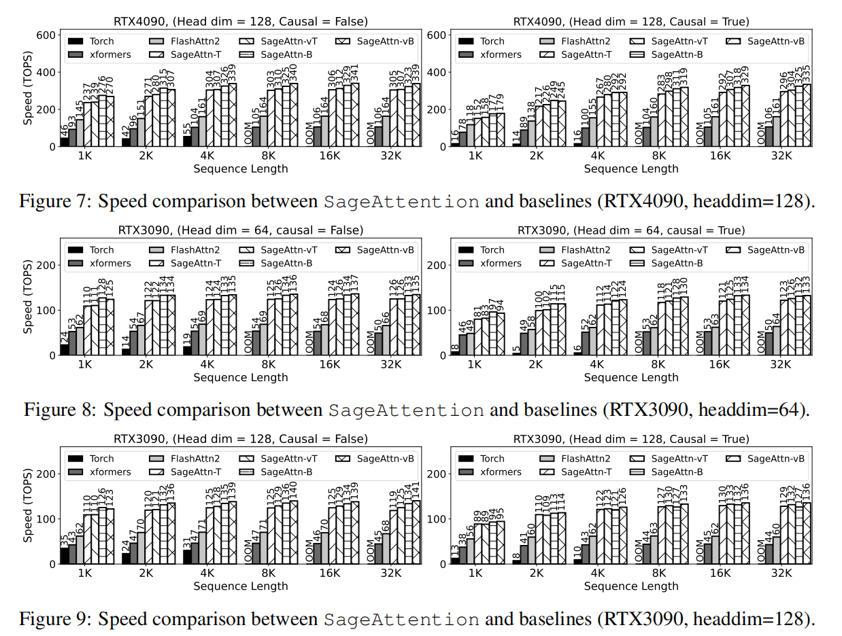
SageAttention

Slide 8
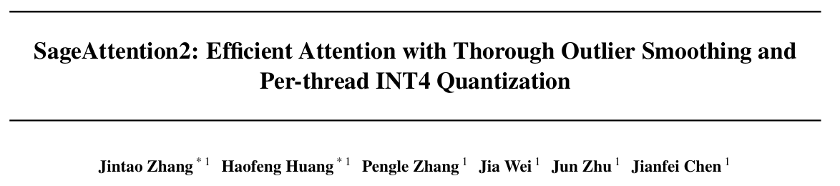
SageAttention2
ICML’25

Slide 9
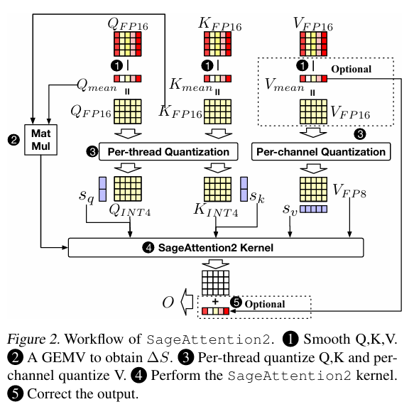
SageAttention2

Slide 10
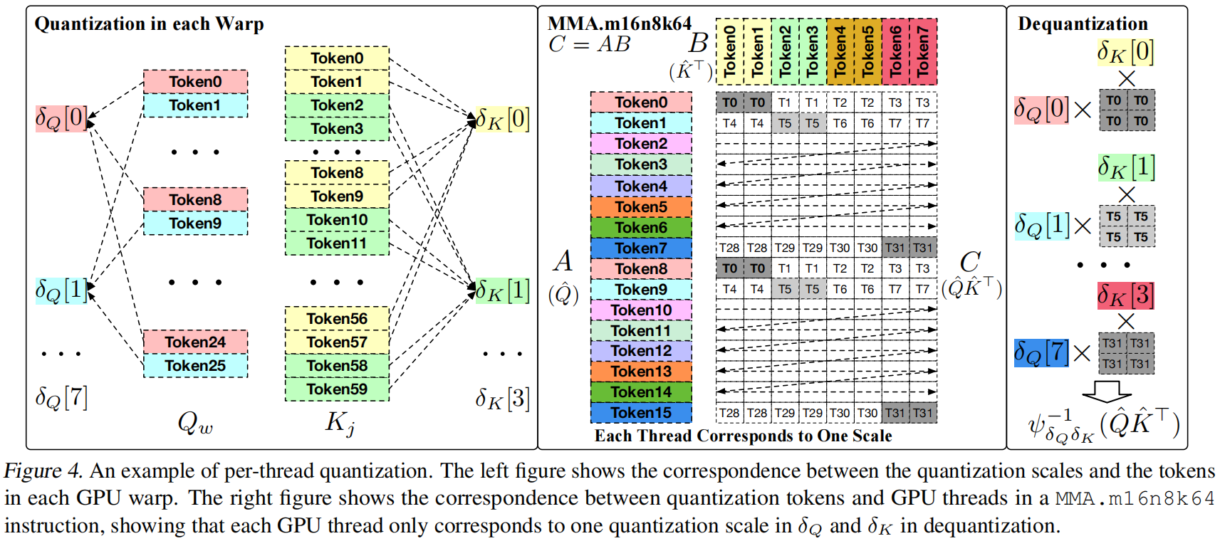
SageAttention2

